Slide 1

A Short Course on Robust Climate Policy
Module E: Frameworks, Carbon Pricing and the Carbon Pricing Assessment Tool (CPAT)
Stephen Stretton
Climate Economics
American University, Kyiv
August 2024

Slide 2
Table of Contents
Course Outcomes
Reading List
National Climate-Fiscal Policy
  Carbon Pricing
  Regulations
  Renewables Targets and Auctions
  Investment
    Derisking
    Financing

Slide 3
Three Key Outcomes
Introduction to Climate Economics: Explore climate economics through a fiscal lens, focusing on national and international efforts to achieve Paris Agreement targets.
Comprehensive Approach to Green Transition: Analyze the fiscal, financial, and energy security aspects of transitioning to a green economy, with a focus on perspectives relevant to middle-income countries like Ukraine.
Preparation for Professional Opportunities: Prepare participants for potential roles in the World Bank by developing skills for Short Term Consultancy (STC) opportunities.

Slide 4
World Bank Group (2024), ‘State and Trends of Carbon Pricing’.

Slide 5
“Carbon pricing can be one of the most powerful tools available to policymakers to incentivize reducing emissions as part of an integrated policy mix. A decade ago, carbon pricing policies covered only 7% of global emissions. Today, nearly a quarter are covered by these instruments… Despite the positive trends that are outlined in this year’s report, higher pricing and wider coverage are going to be essential to really unlock the potential of carbon pricing. This will require political commitment, stronger global frameworks, and initiatives to share best practices that can help drive ambition. Time is not on our side as countries will need to move further, faster to decisively bend the emissions curve and safeguard a livable planet ”
(World Bank State and Trends of Carbon Pricing’’ Report, 2024)

Slide 6


Slide 7
Why Do We Need This?
1. Robustness: Ensures overall coordination of energy supply and demand, enhancing system reliability and energy security.
2. Carbon Pricing Limitations: Carbon pricing alone is insufficient for scaling up renewables due to market volatility, which can deter long-term investments.

Slide 8
Regulations
Emission Reduction Targets
Clear, enforceable targets for reducing GHG emissions by specific dates.
Sectorial regulations to control emissions in key industries.
Renewable Energy Standards
Renewable Portfolio Standards (RPS): Mandate a minimum percentage of electricity from renewable sources.
Clean Energy Standards (CES): Broaden RPS to include other low-carbon energy sources beyond renewables.
Land Use and Environmental Protection
Deforestation Regulations
Wetland and Coastal Protections
Energy Efficiency Regulations
Building Codes
Vehicle Emission Standards
Appliance Efficiency Standards
Climate Risk Disclosure and Reporting
Corporate Reporting Requirements
Financial Sector Regulations

Slide 10
Mechanism: Price of emissions set by regulators. Carbon emitters pay for each unit of carbon they produce. Price of carbon is fixed, while the quantity of carbon emitted is determined by the market.
Pros:
    Price certainty
  Generates tax revenue
Cons:
  Emissions uncertainty
  Politically challenging
Carbon Tax

Slide 11
Mechanism: Total quantity of emissions set by regulators. Carbon emitters buy 'emissions allowances' from regulators and each other. Price of emissions is determined by the market, while the quantity of emissions is fixed.
Pros:
Emissions certainty
Politically less challenging (due to free permits)
Cons:
Price uncertainty (may impact green investment)
Free permits reduce tax revenue
Emissions Trading System

Slide 12
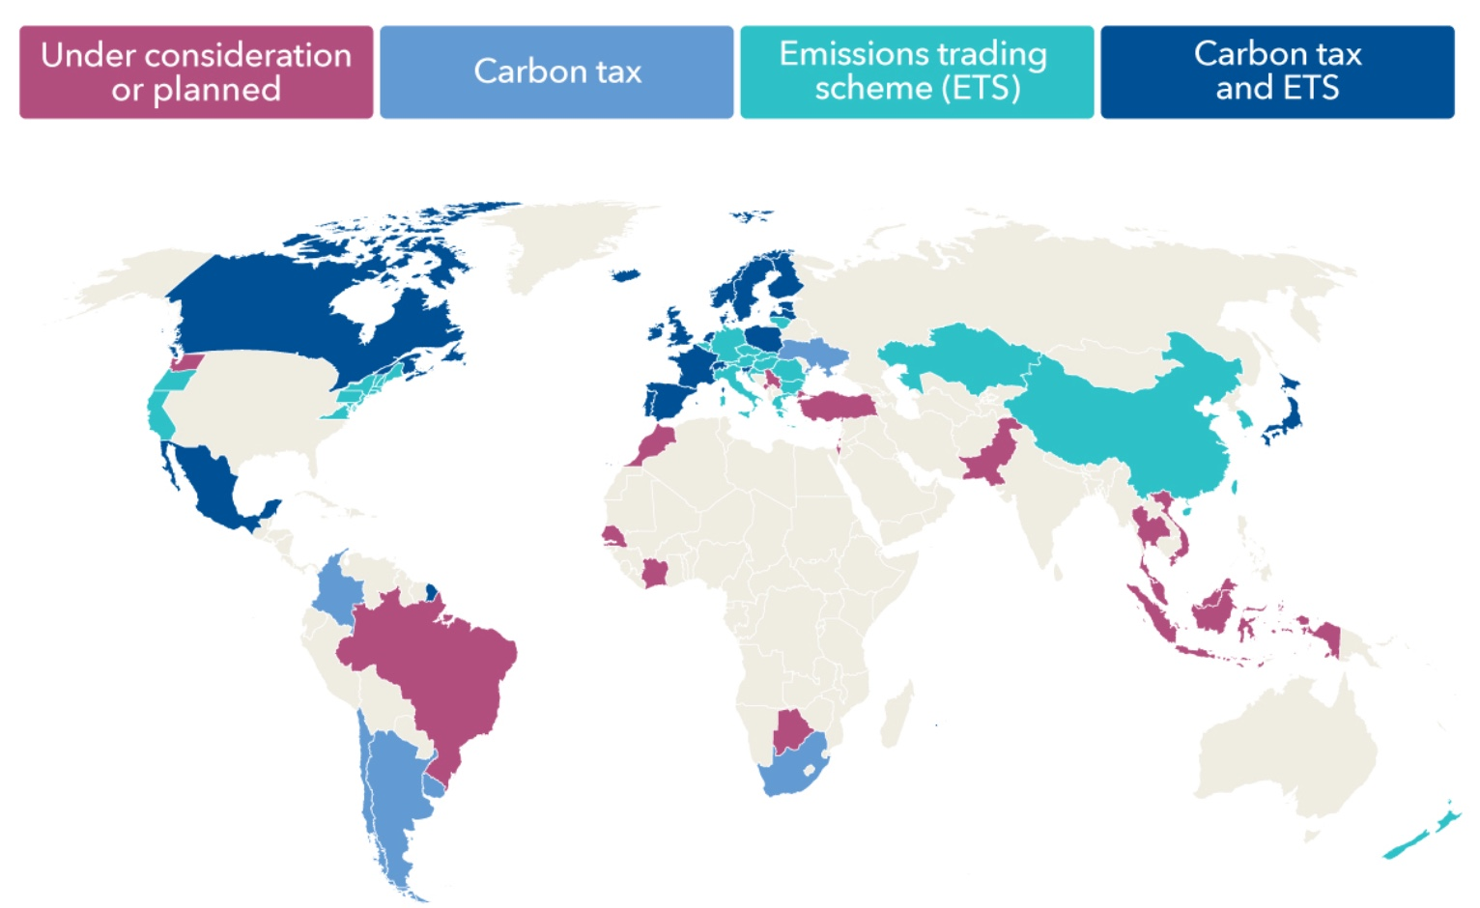
Carbon Pricing Coverage
Carbon pricing instruments currently cover around 24% of global emissions (WB, 2024).
Source: IMF (2022)

Slide 13
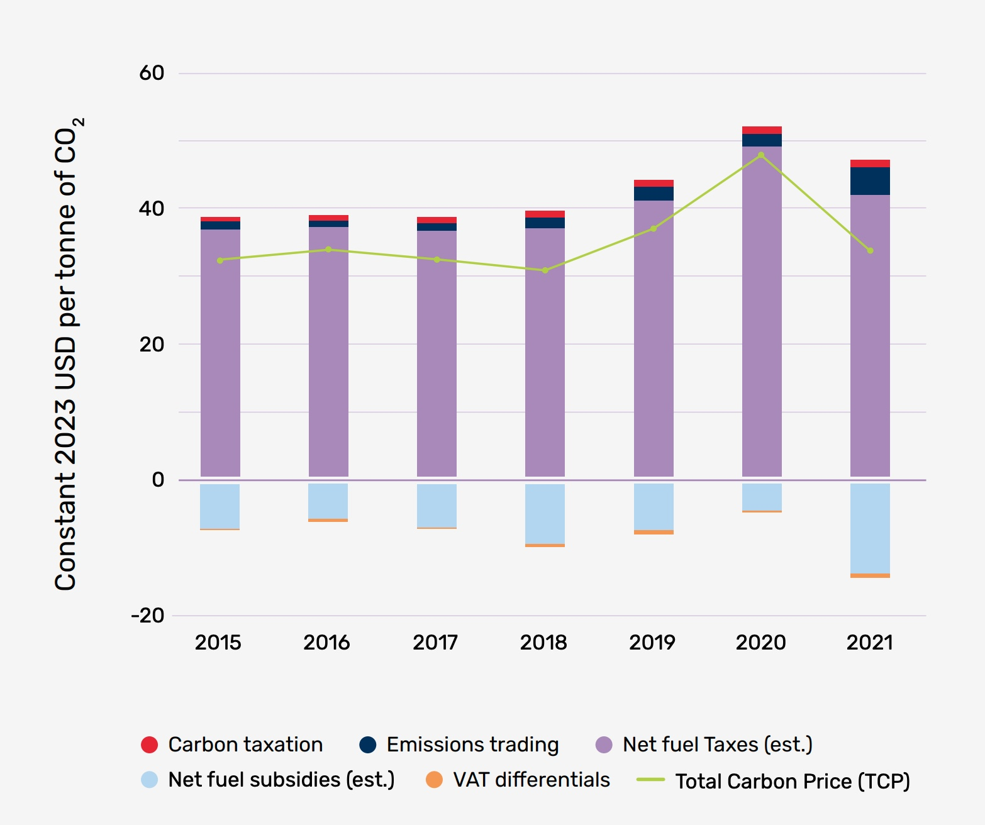
Global Total Carbon Price 2015-2021 (USD 2023)
Existing carbon price incentives, even if they include indirect carbon pricing, are insufficient to deliver the transformational changes needed to meet the Paris Agreement goals.
(WB, 2024).
Source: WB (2024)

Slide 14
Rethinking Carbon Pricing
Four Functions of Carbon Pricing:
  Transition: Scale Up Renewable Energy (RE)
  Transition: Scale Down Fossil Fuels (FF)
  Polluter Pays
  Remediation
Traditional implementation ignores (4- Remediation) and finds it politically difficult to combine (1) (2) and (3).
Notes:
Remediation for who?

Slide 15
Rethinking Carbon Pricing
Alternative Approach:
  Scale Up: RE Auction System to scale up clean energy (overlaps with energy)
  Scale Down: Feebates (Political Economy)
  Polluter Pays for Long-Term Liability: Dealing with Remediation

Slide 17
What is it?
Covers around 180 countries​.
Helps design, compare, and implement different policies​.
Provides rapid estimation of multiple effects of climate policies​.
Covers carbon pricing, taxes, feebates , efficiency policies, fossil fuel subsidy reform, and power sector-specific policies.

Slide 18
